Slide 1

Covid-19 vs. Past Pandemics
- H1N1 (2009)
- Ebola (2014-2016)
- Influenza (2009-2019)
Brent Thomas
Matt Houser

Slide 2
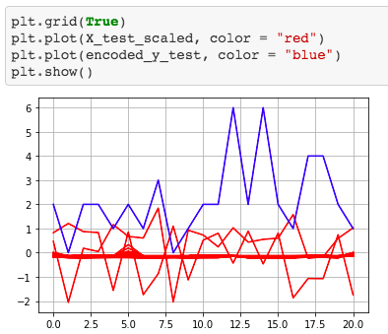

Covid-19 *Confirmed Deaths-Global*
Training Data Score: 0.754
Testing Data Score: 0.714

Slide 3
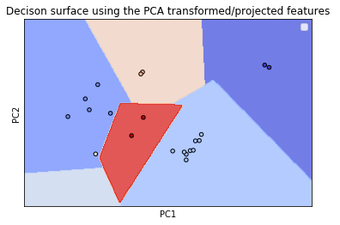
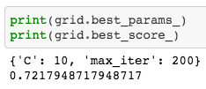
Covid-19 *Confirmed Deaths-Global*

Slide 4
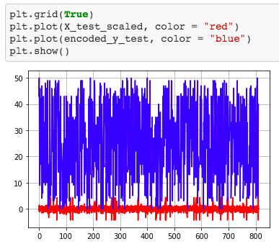

Covid-19 *Confirmed Deaths-United States*
Training Data Score: 0.934
Testing Data Score: 0.921

Slide 5
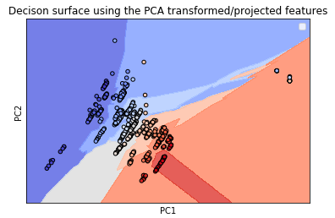

Covid-19 *Confirmed Deaths-United States*

Slide 6
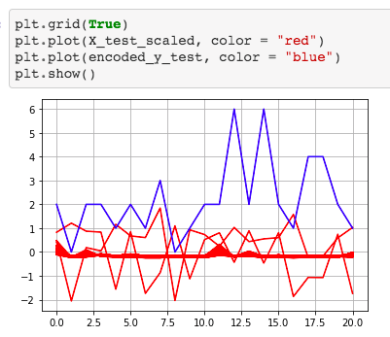

Covid-19 *Confirmed Cases-Global*
Training Data Score: 0.988
Testing Data Score: 0.986

Slide 7
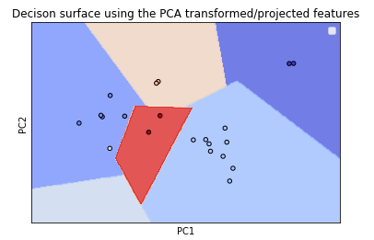
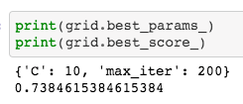
Covid-19 *Confirmed Cases-Global*

Slide 8
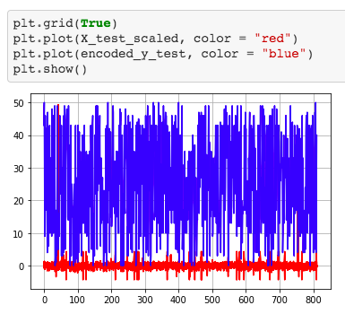

Covid-19 *Confirmed Cases-United States*
Training Data Score: 0.938
Testing Data Score: 0.912

Slide 9
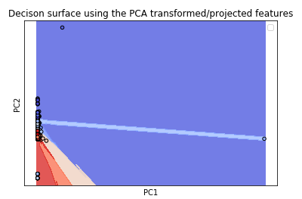
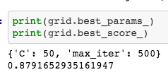
Covid-19 *Confirmed Cases-Global*

Slide 10
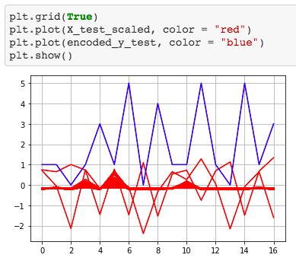

Covid-19 *Confirmed Recoveries-Global*
Training Data Score: 0.8
Testing Data Score: 0.824

Slide 11

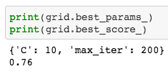
Covid-19 *Confirmed Recoveries-Global*

Slide 12
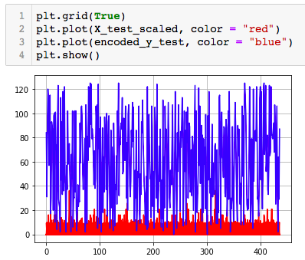

H1N1 (2009)
Training Data Score: 0.988
Testing Data Score: 0.986

Slide 13
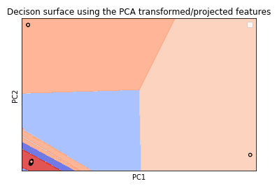

H1N1 (2009)

Slide 14
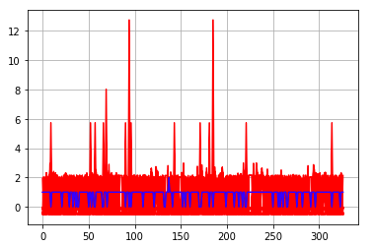
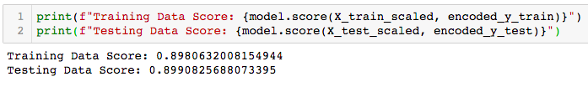
Ebola (2014-2016)
Training Data Score: 0.898
Testing Data Score: 0.899

Slide 15
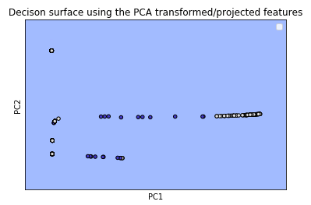
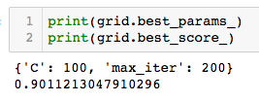
Ebola (2014-2016)

Slide 16
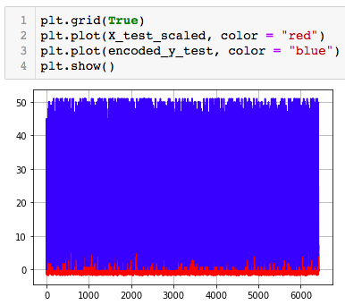
Influenza (2009-2019)
Training Data Score: 0.079

Slide 17
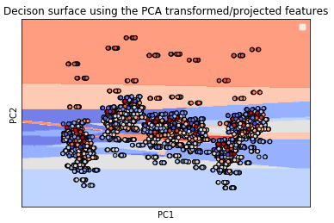
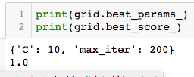
Influenza (2009-2019)

Slide 18
Influenza Total Deaths by Age (2009-2019)
65 Years and Older
64-18 Years Old
17-0 Years Old
37,421
14,269
1,424

Slide 19
United States Comparison
 | Cases | Deaths
Covid-19 | 1,132,539 | 66,369
H1N1 (2009) | 358,659 | 1,194
Ebola (2014-2016) | 967 | 242
Influenza (2009-2019) | Unknown | 159,342

Slide 20
Covid-19 Confirmed Cases (Top 10)
U.K. (4)
Russia (8)
France (5)
Germany (6)
U.S. (1)
Spain (2)
Italy (3)
Turkey (7)
Iran (10)
Brazil (9)

Slide 21
H1N1 Confirmed Cases (Top 10)
U.K. (5)
Canada(3)
U.S. (1)
Japan (7)
Mexico (2)
China (9)
Thailand (2)
Chile (4)
Argentina (8)
Australia (6)

Slide 22
Ebola Confirmed Cases (Top 10)
U.K. (9)
Spain (8)
U.S. (6)
Italy (10)
Senegal (7)
Mali (5)
Guinea (3)
Sierra Leone (1)
Liberia (2)
Nigeria (4)

